Slide 1
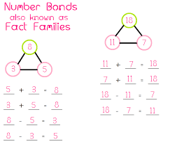
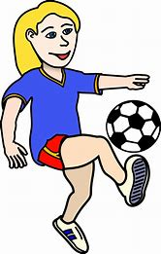
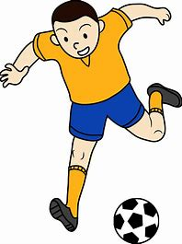
Class 1 - Term 2
Rainbow Bear;
The Arctic
Welcome back to Term 2. We have lots to look forward to this term and a busy start. On Thursday 5th November we are having a Forest School session where we are going to light a bonfire. Also, on Tuesday 10th November we are going to have a visit from the fire service who will give us a talk on fire safety. This would normally happen in Term 1 to support our topic last term, but they are only just resuming school visits, albeit scaled back. The children have always enjoyed these visits in the past and find them very interesting and informative. We will also be celebrating Science Day on Tues 10th so will be spending the rest of the day doing all things scientific.
Our topic this term is The Rainbow Bear which is a book about a polar bear by Michael Morpurgo. We will be finding out a bit about where we live and where the Arctic is in comparison. We will be learning about the landscape and climate, the different types of animals that live there and how they are adapted to survive in that environment. For more information about what we will be covering and key vocabulary linked to this topic, please look at the Class 1/Term 2 page on our school website. In maths this term we will initially be learning addition and subtraction. Firstly we will be looking at number bonds within 10 and fact families e.g. 0 + 7 = 7 Our KIRF for this term is: I know number bonds for each number to 10 (see attached sheet). Later in the term we will be looking at 2D and 3D shapes.
PE will still continue to be on Mondays and Wednesdays. This term we are lucky to have a coach in to teach football skills. As much as possible – weather permitting – this will be outside so your child will need suitable warm clothing (joggers and sweatshirts) and trainers. Thank you.

Slide 2
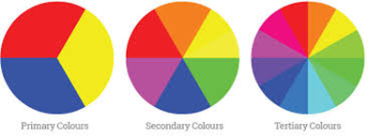
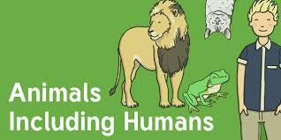
We will be reading a great book in literacy called Harold and the Purple Crayon and the children will write their own version of the story. For non-fictional writing, we will be writing a fact file about an Arctic animal. Alongside this we will continue our daily phonics, reading and story time sessions. Our Science topic is Animals including Humans in which the children will learn about physical characteristics that are both shared and different between animal species. In RE, we will be thinking about how we celebrate our journey through life and how Christians celebrate birth – which will lead us into the story of the Nativity.
We have a great Art topic called Colour Chaos where we will be learning about the primary colours and then mixing them to create secondary and tertiary colours. We will be looking at different artists and how they use colours, tints and shading to create different effects. In ICT we are continuing with Purple Mash. It is important that your child learns how to log in independently as we encourage this at school. We are going to spend 3 weeks learning how to create pictograms using the 2Count app before moving on to ‘algorithms’ - which is following a precise set of instructions to achieve a goal. This is the basis of coding. As always, we will also be talking about keeping safe online when using computers and tablets; such as always asking for permission, ensuring that internet usage is supervised and equipping children to be able to say if they see something they don’t like. like.
… for continuing to support your child with their reading – it really is the foundation for effective learning through the whole curriculum. Your children have had some time to use Numbots and Teach Your Monster to Read in school but these are great to use for short bursts at home if possible. … to everyone who has already signed up to Class Dojo. It is a great way for me to send a message to all if necessary or for contacting me if you have been unable to ‘grab’ me at the start or end of the school day. I will also upload some photos and information to the class page of the school website.

